Slide 1
ICP-Presentation Two
Yugandhar Reddy Yarava : 16307855
Anurupa Velpula : 16313423

Slide 2

Login Application
Creating a basic login application which takes the username and password to login.

Slide 3
Basic Login with validation
In Android Studio, I created an empty project and installed a Google Pixel 5 emulator with Android OS version 12.
Basically, design a login page with Username and Password fields and a login button as the user interface.
When a user's username and password are the same, he or she will be able to sign into the application successfully.
An error notice stating "Username/Password is wrong" appears when the username and password are incorrect.

Slide 4

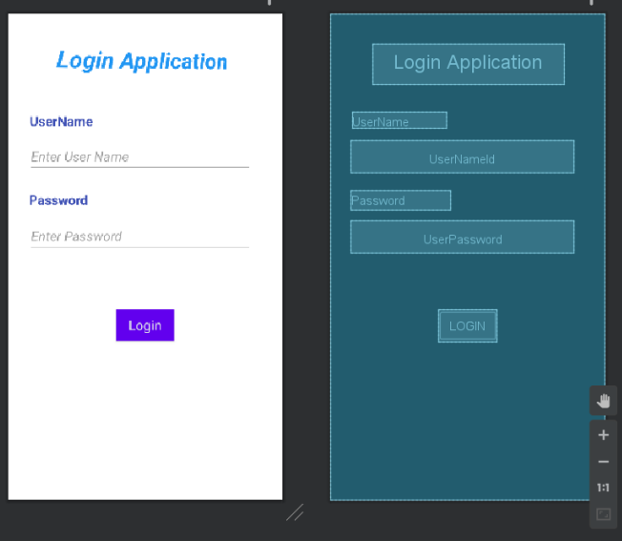

Slide 5
My Pizza
Pizza ordering APP

Slide 6
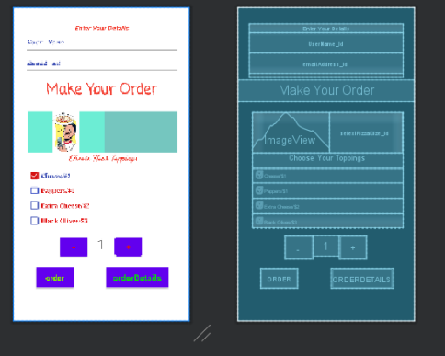
Pizza App
Created a pizza ordering application.
Functionality,
Selecting pizza toppings
Quantity
Place order
Summary

Slide 7
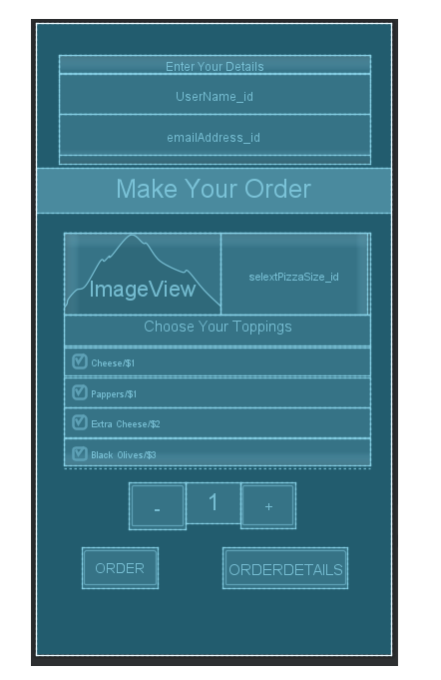
Summary page

Slide 8
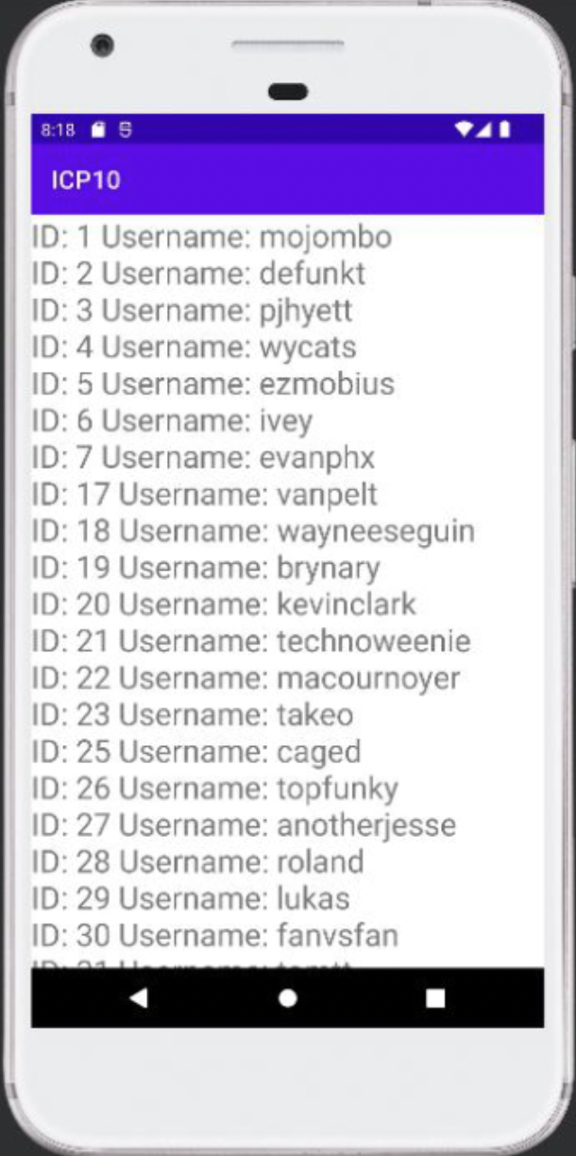
built a new java class file called User.java that works as a data transfer object with getters and setters for id and username.
Retrofit programming interface is used to acquire the users information in the onCreate work in MainActivity.java, which consumes the github rest programming interface.
The reaction is gathered in the onResponse strategy and projected to the User class, which is gathered in the rundown, after a successful call of the programming interface. The user is then shown the information.

Slide 9
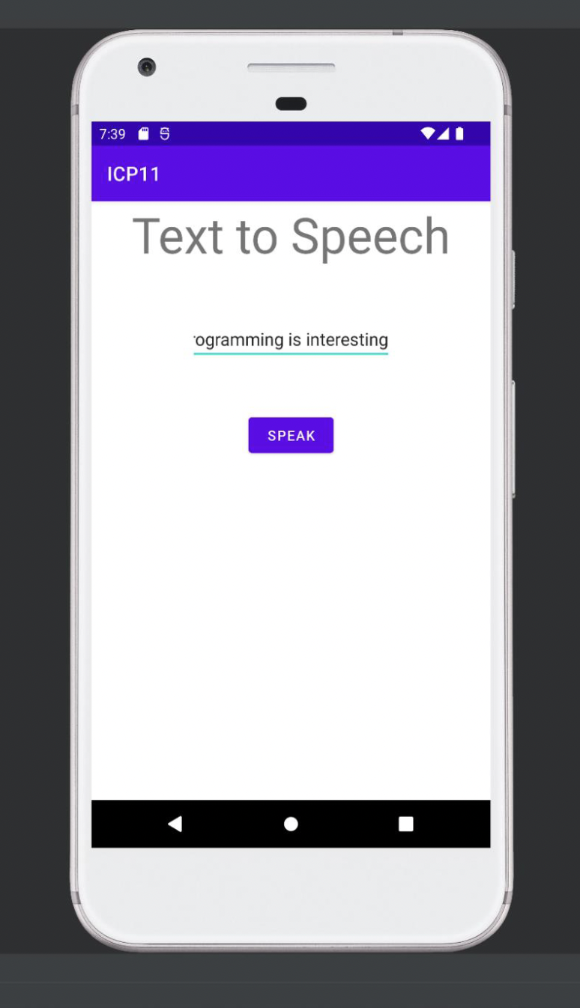
Text to speech
In the mainactivity.xml, We included textview, edittext, and a button with an id for each tag.
An event listener is added when the button is clicked, and this is where the text to speech conversion takes place.
For the transformation process, text to speech (an Android built-in package) is used.
Text to speech is a programming interface included in the Android operating system that, upon success, selects English as the locale and then initiates the transformation process.
The speak method is used to convert text to speech, resulting in the output of the speech.

Slide 10
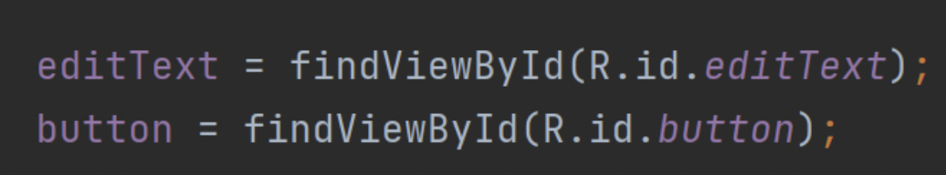
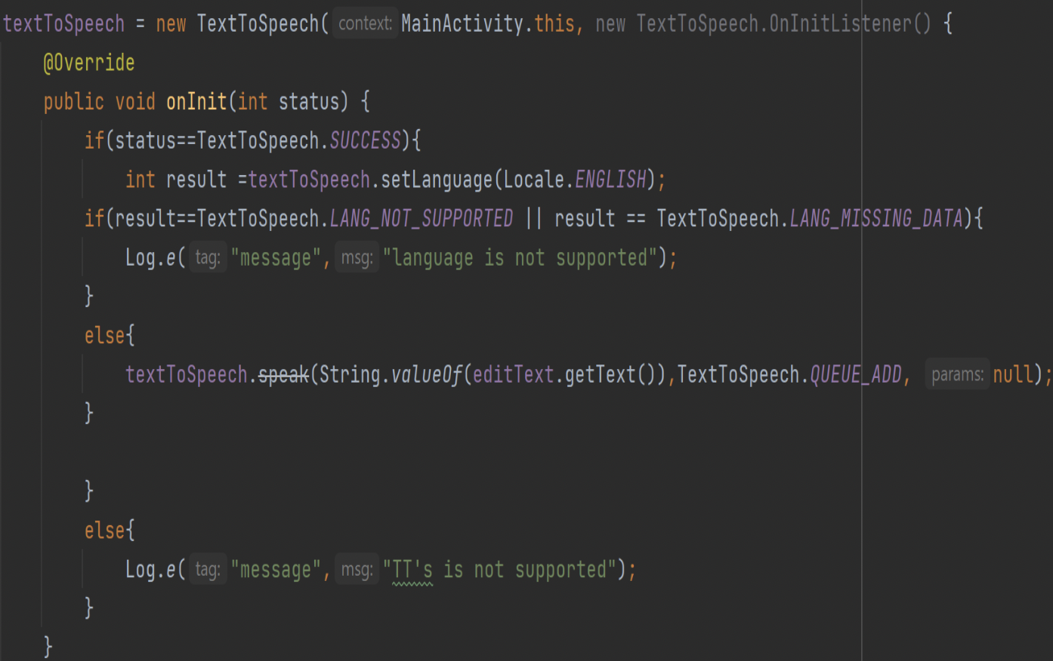
Fetching the data using Id’s
Text to speech logic which handles error and success scenario’s

Slide 11
THANK YOU

